Slide 1


NCBA BOOSTA
CUSTOMER JOURNEYS
PG | 1

Slide 2
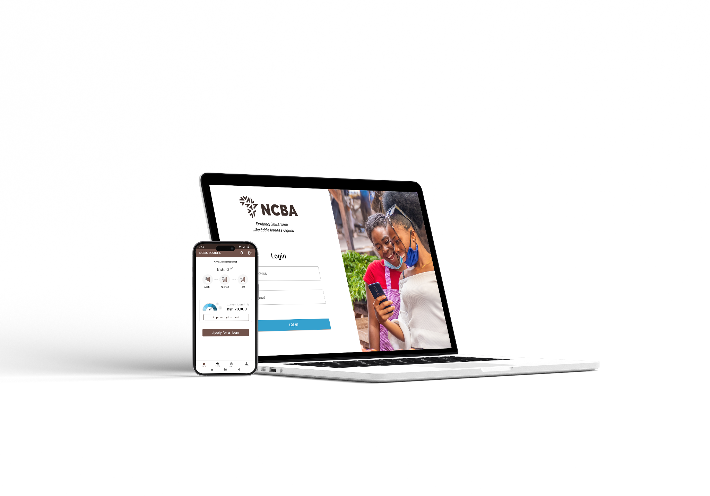
Contact Center Support: Levels of Support to Customers
Customer raises query
Call to Contact Center
NCBA BOOSTA Digital
Enquiry for Product eligibility?
(Means haven’t received invitation to product)
Limit & Technical Query
Client cant access limit
Repayment challenge
Login & channel use Query
Support to Contact Center
Training conducted
Refresher training scheduled on 17th Sept
Quarterly trainings
FAQs shared with contact center & branch CPAs
Refer customer lead to Branch
Ecosystem CPA will own
Refer the issue to Ecosystem team and to Branch
David Wanyoike - OPS
Customer Service
Assist with reset and use on APP/web
Branch to onboard anchor
Branch to execute anchor & retailer onboard
CPA target client
Reach out to Customer

Slide 3
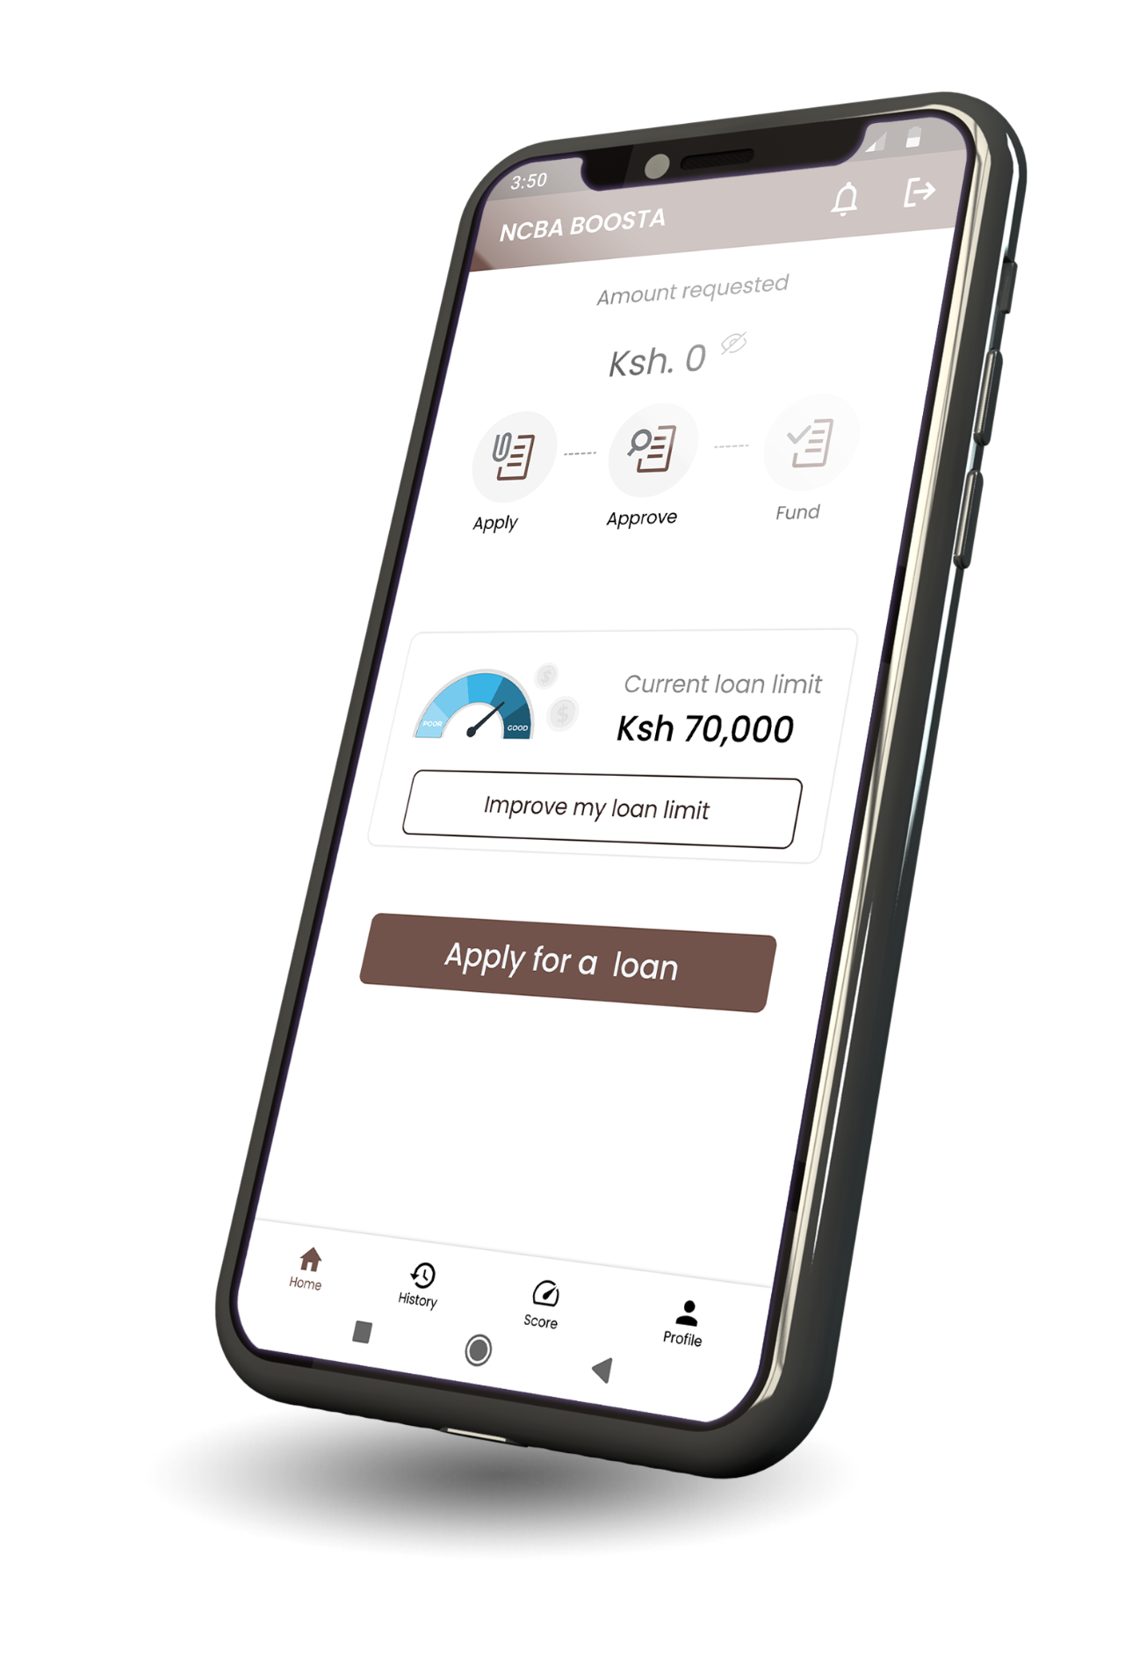

NCBA BOOSTA App
User Interfaces

Slide 4
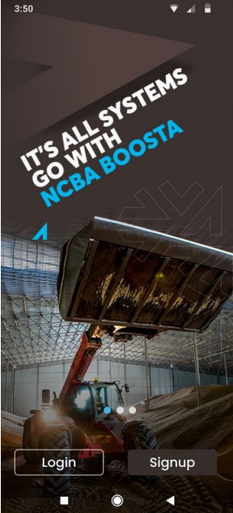
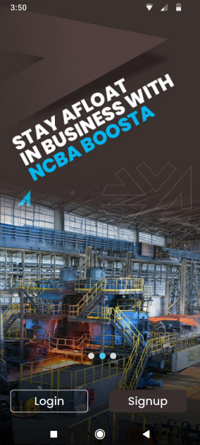
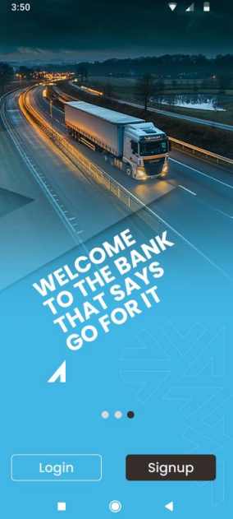
Sign in & Sign up - Splash Screens
The splash screens give the customer more information about the product and how to navigate the journey
On successful data upload, the user gets an invite SMS with a link to download the APK
Sample Invite SMS
Dear customer, you have been shortlisted by EABL for an NCBA BOOSTA Loan to grow your business. Your current loan limit is KES 10M. To apply kindly visit https://boosta.ncbagroup.com
For New users: Use Sign Up
For registered users: Use Sign In

Slide 5
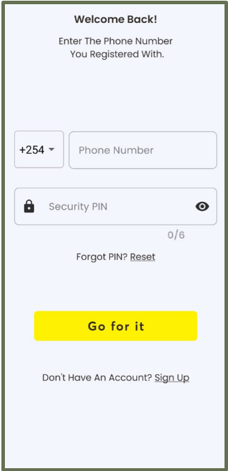
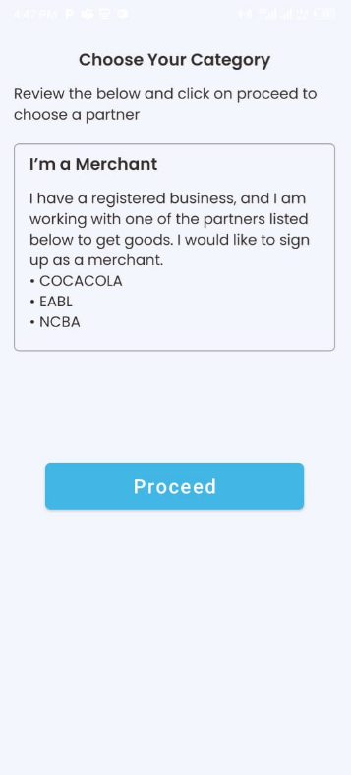
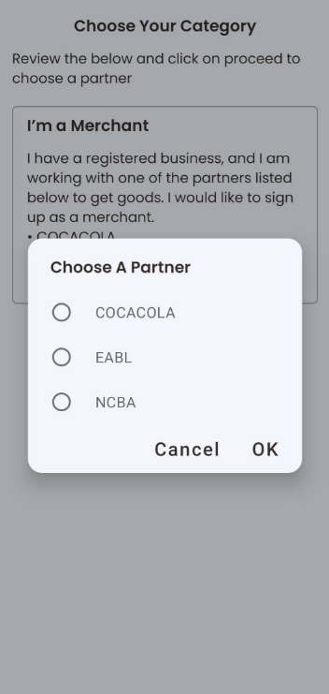

Step 1: Welcome page
The landing page allows the 1st time users to proceed with registration while existing users to login to the platform
Existing users
Select the Anchor to proceed
1st time users

Slide 6
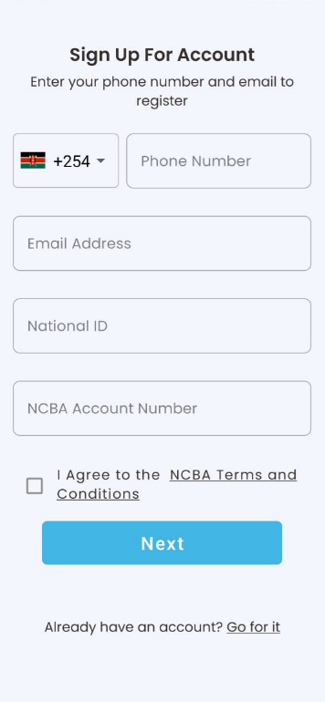
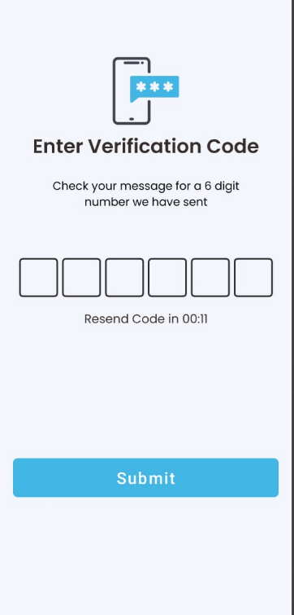
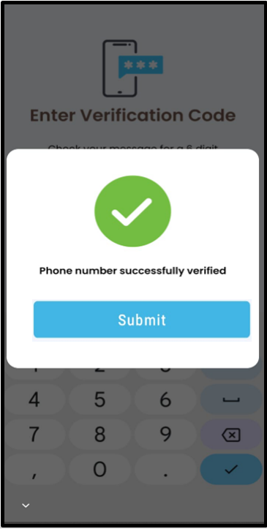
Step 2: Customer details validation
The customer should enter their personal details as they exist in the core banking
For Existing Customers
Enter NCBA Account to proceed
For New to Bank Customers
Open an NCBA Account either digitally or at the branch to proceed

Slide 7
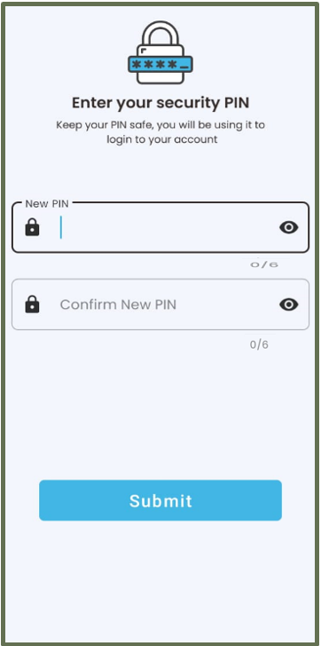
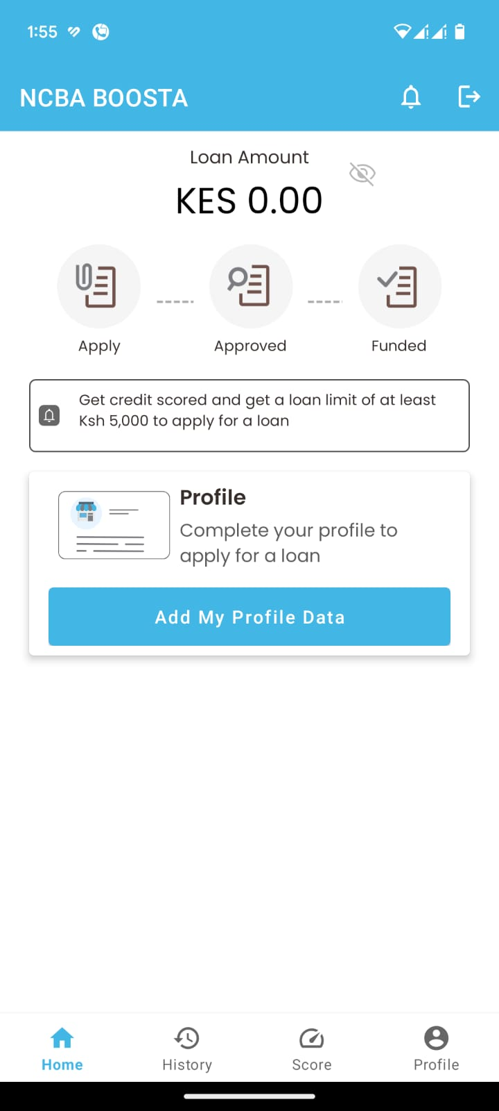
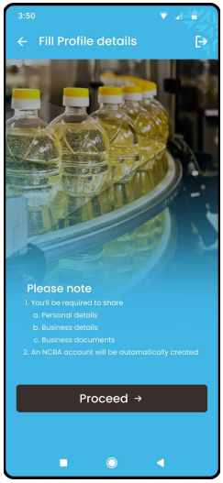
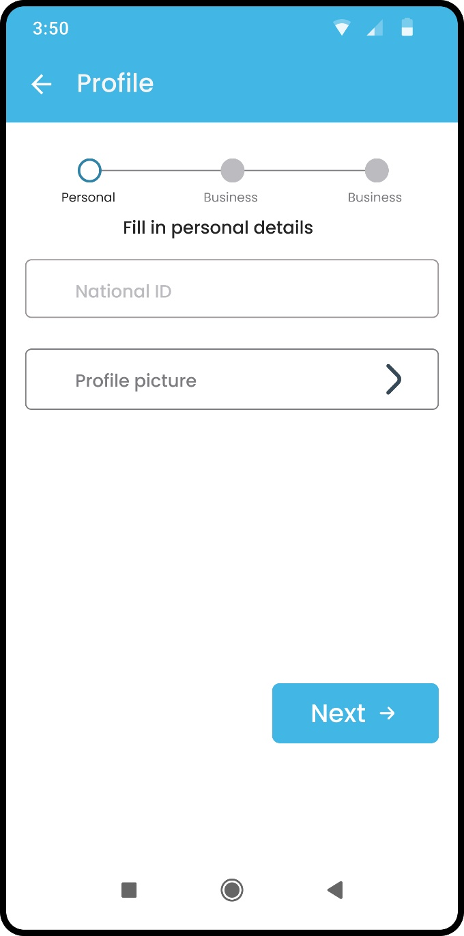
Step 3: Customer Profile Update
The customer will be prompted to create a new PIN and thereafter proceed to update their personal profile

Slide 8
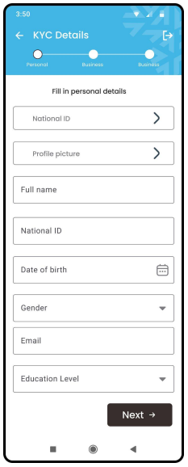
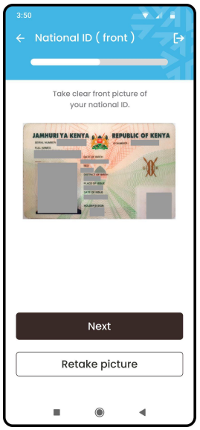
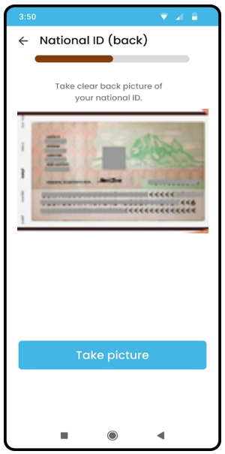
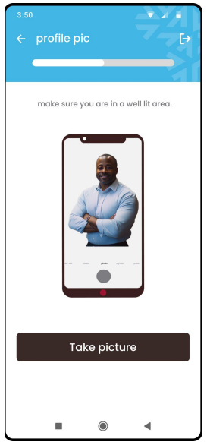
Step 4: Upload KYD Documents (Personal)
Upon filling of the personal details, the customer will proceed and upload the ID copy and take a photo

Slide 9
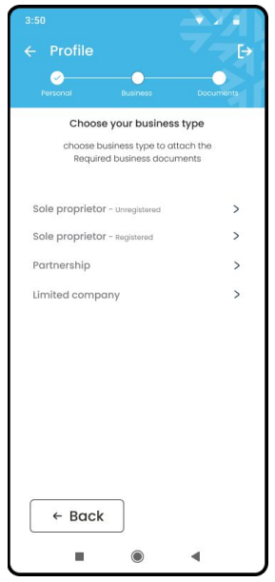
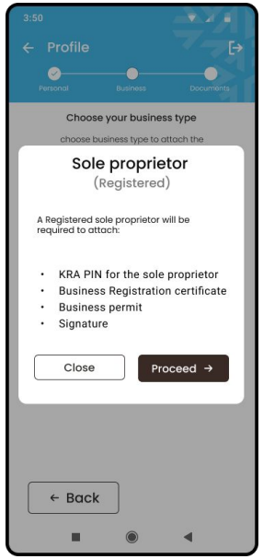
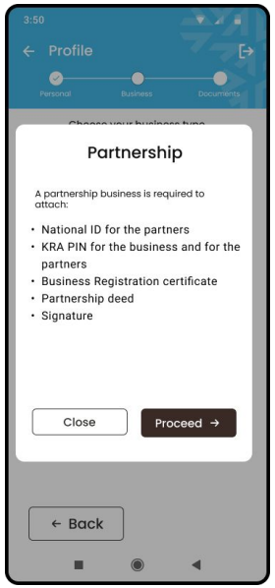
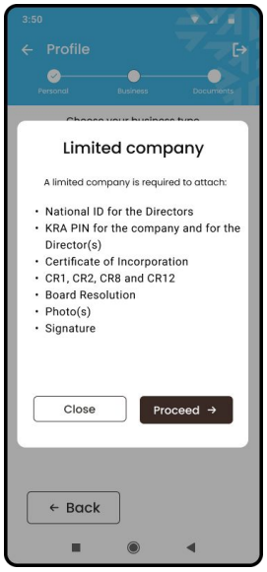
Step 5: Choose Business Entity
The customer will choose the business entity operated. This will dictate the documents to be submitted

Slide 10
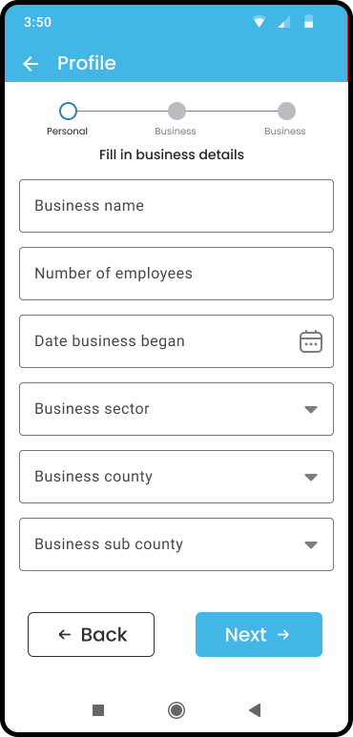
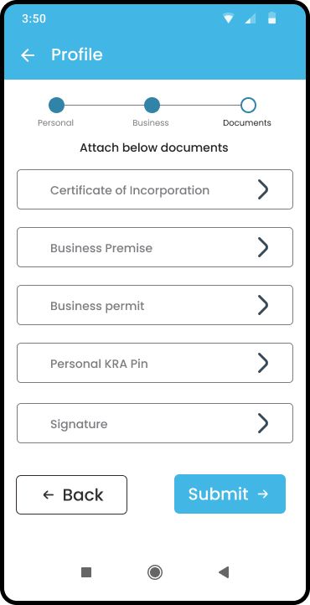
Step 6A: Business Profile Update
The customer will proceed and fill out the business details
Business entity profile

Slide 11
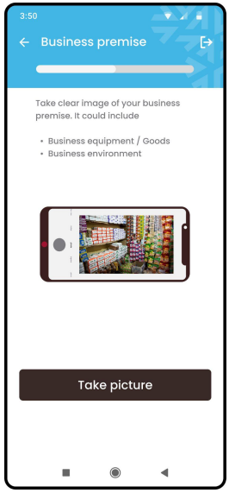
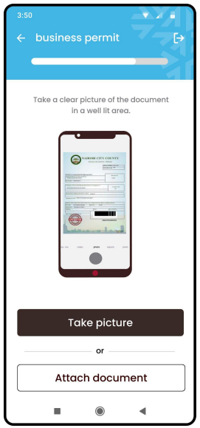
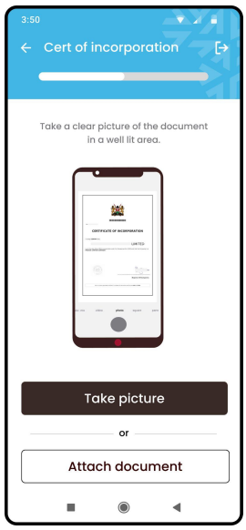
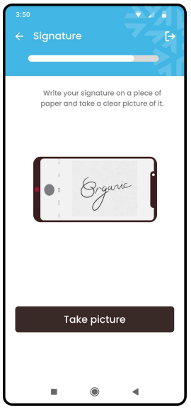
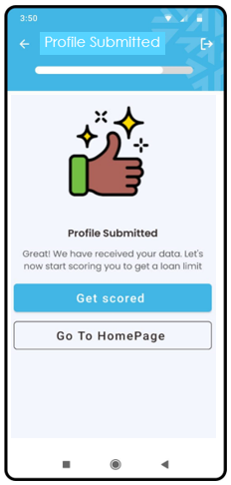
Step 6B: Business Documents Upload
The customer will proceed and upload the business documents – Business permit or licenses, registration certificate

Slide 12
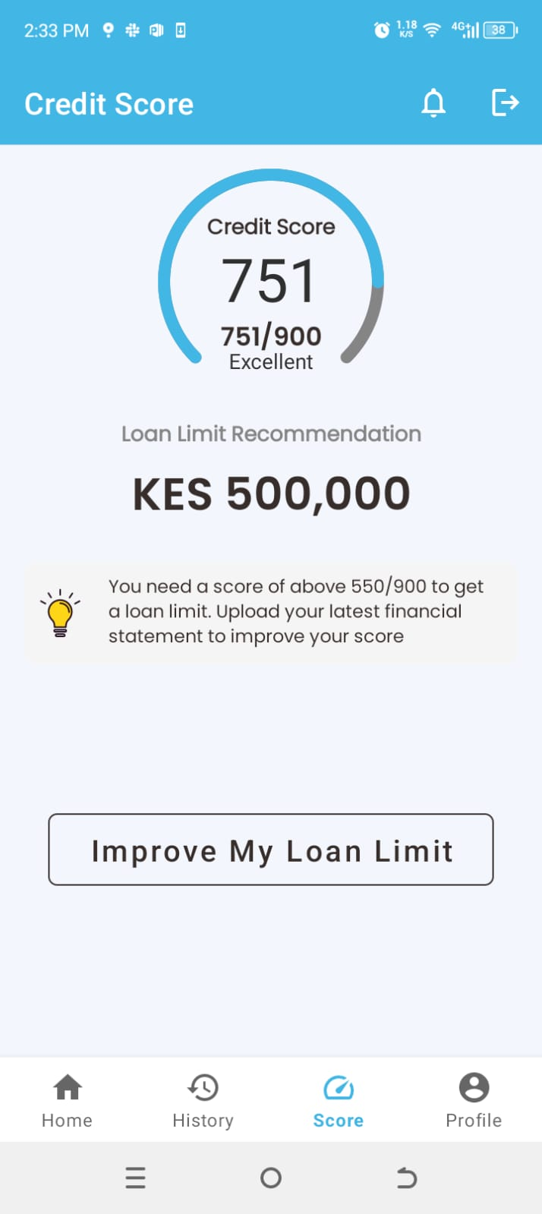
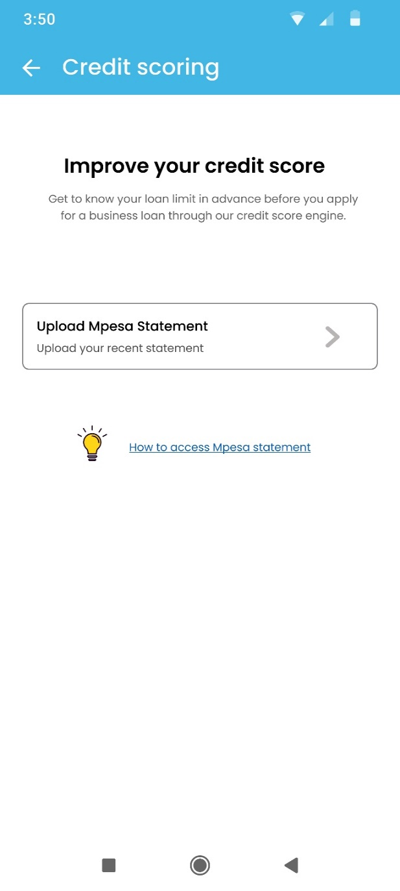
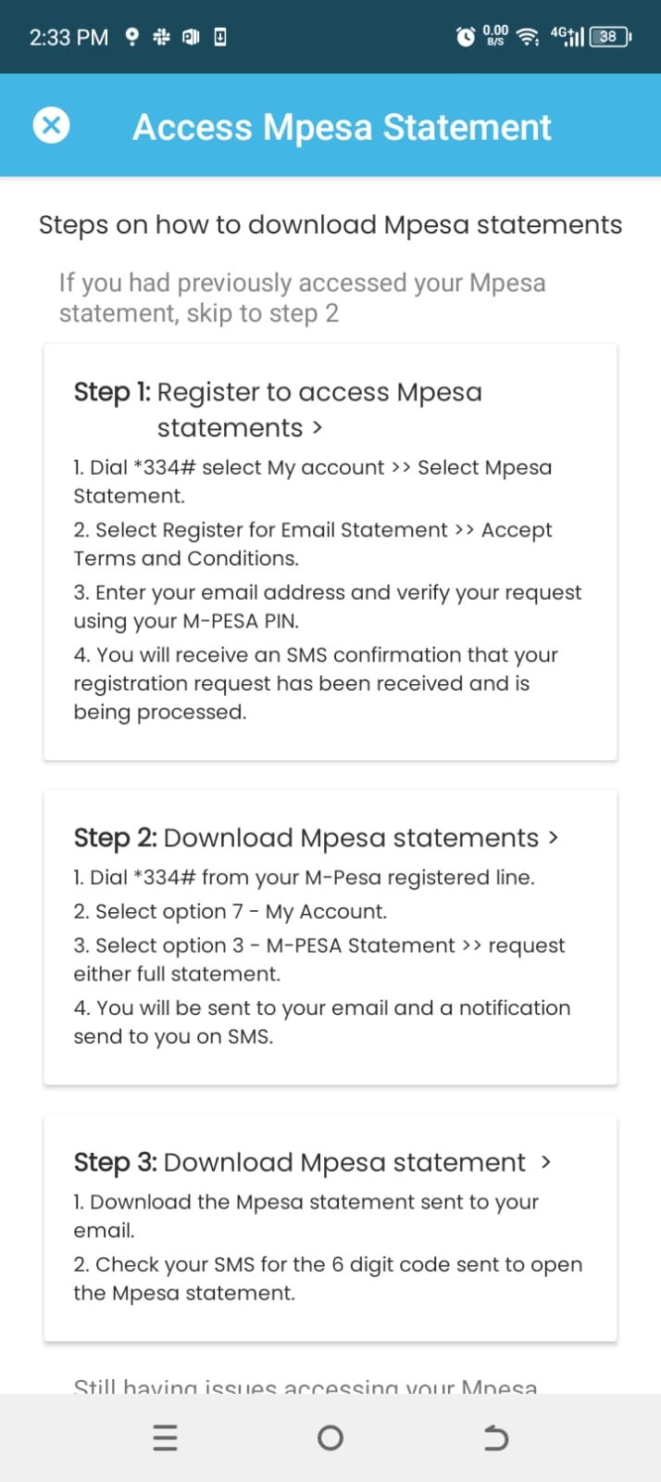
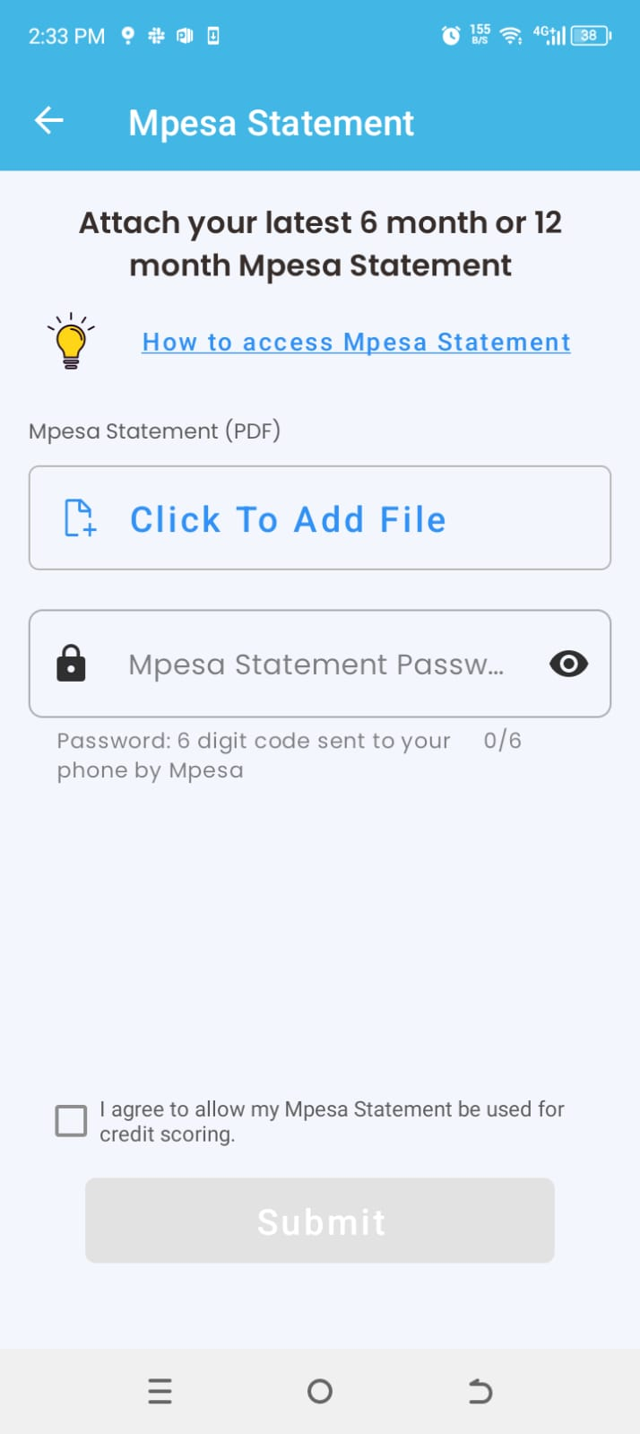
Step 7: How to improve the score
In case the customer is not satisfied with the limit allocated, they can upload their M-Pesa statement to improve the score

Slide 13
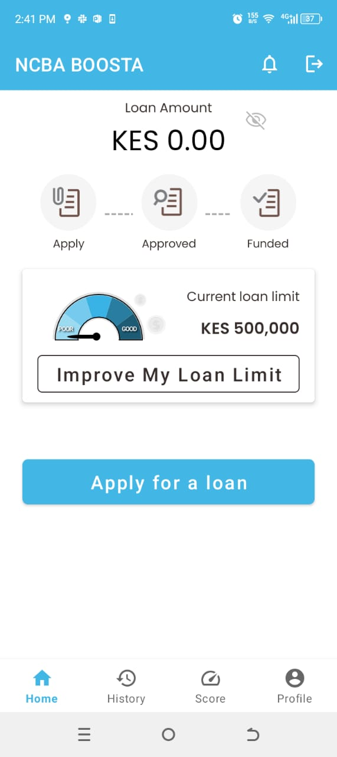
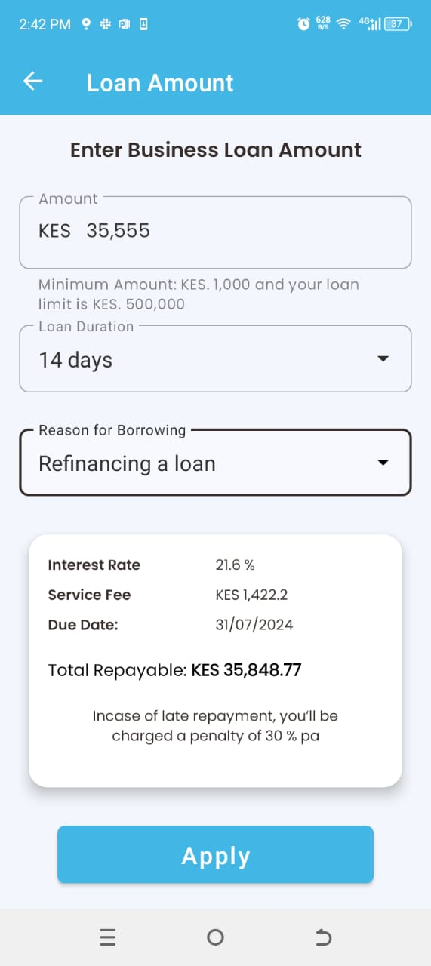
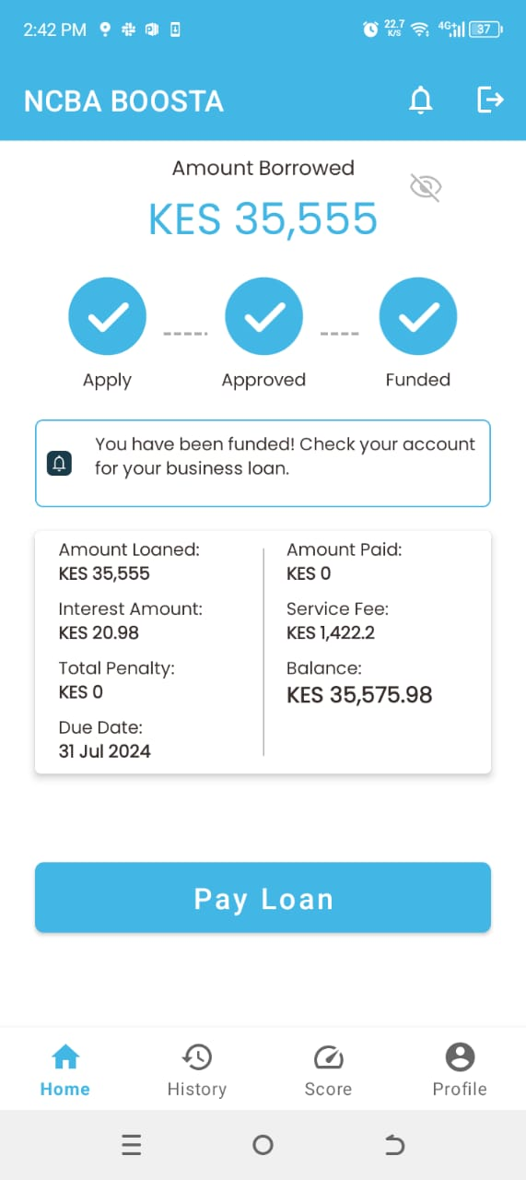
Step 8: Loan Application & notifications
Upon confirmation of the amount to be financed, the customer will proceed with loan application and the funds will be disbursed directly to the Anchor’s account and all the parties are notified on the transaction.
SMS to the customer
Dear Bonface, Your NCBA BOOSTA Loan KES. XXXX has been successfully approved and will be disbursed shortly.
SMS to the Anchor
Confirmed. Purchase of KES XXX has been paid by Bonface Macharia to EABL Ref No. FTX24044GAAAE

Slide 14
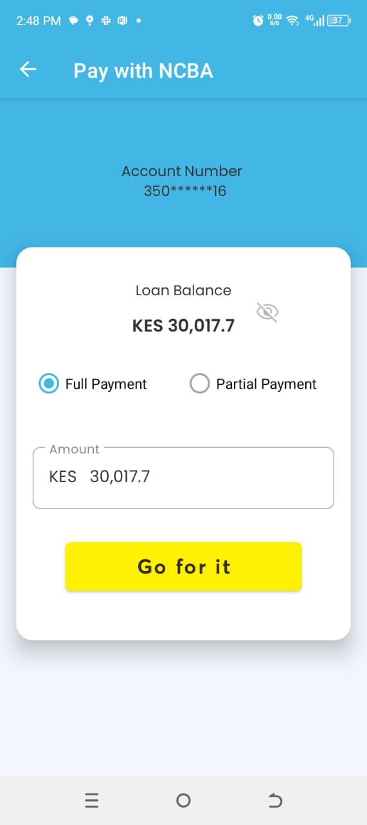
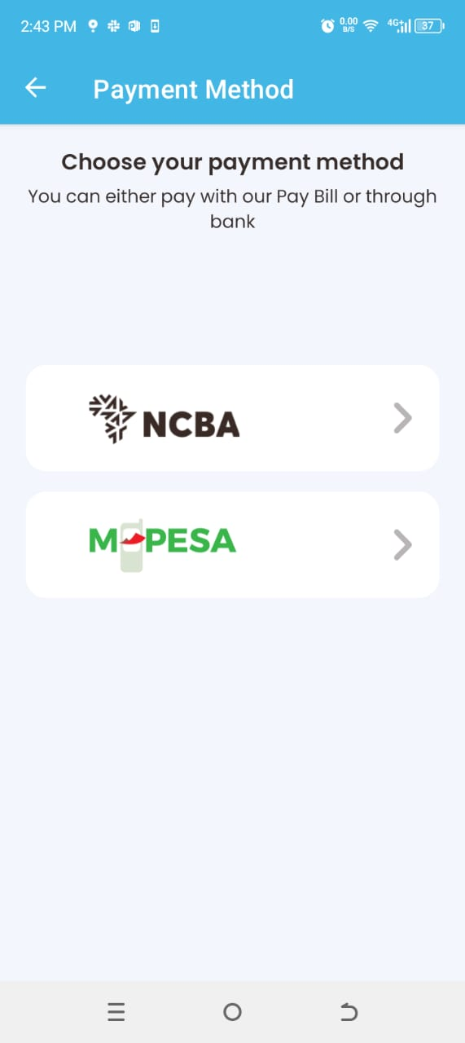

Step 9: Loan Repayment – Partial or Full Payment
On the due date, the system will automatically recover the funds from the customer’s account. However, the customer can initiate the loan repayment for either full or partial payment. The source of funds can be either NCBA account or M-Pesa wallet

Slide 15
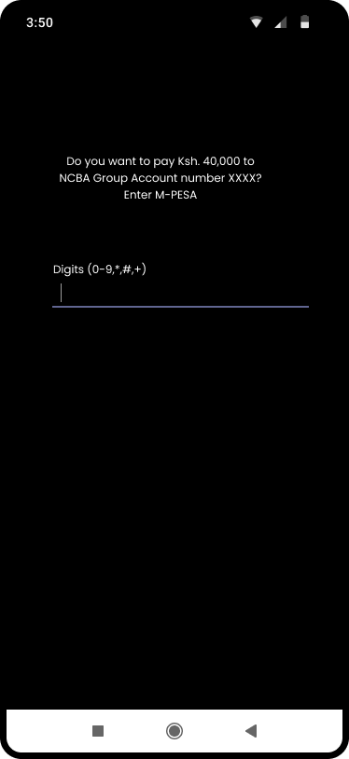
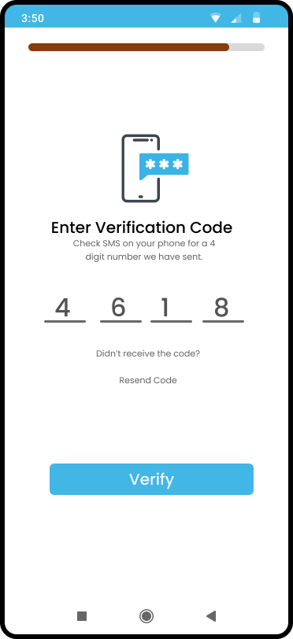
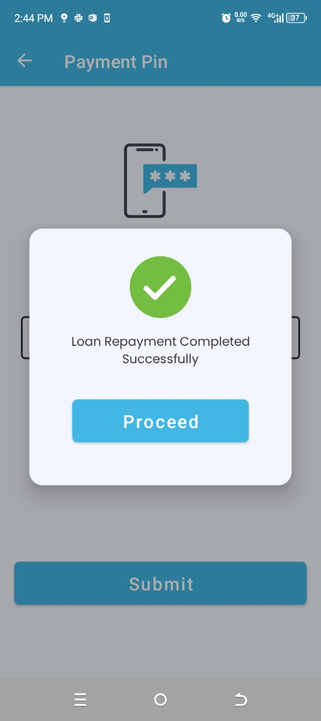
Step 10: Notifications upon Successful Loan Repayment
Upon successful loan repayment, the customer will be notified on the same via an SMS.
Dear Bonface Macharia, your NCBA BOOSTA App Loan repayment initiated. To continue enter OTP 324646. Message Id z3S74/LREQ9
Partial: “Dear Bonface, partial payment of KES 1000.00 on your NCBA BOOSTA loan has been received. Your loan balance is now Ksh 7025.02. For inquiries call 07***64”
Full: “Dear Bonface, You have now fully repaid your loan of amount Kshs 20000.00. To request for another loan visit our NCBA BOOSTA App”

Slide 16
NCBA BOOSTA WebApp
User Interfaces

Slide 17
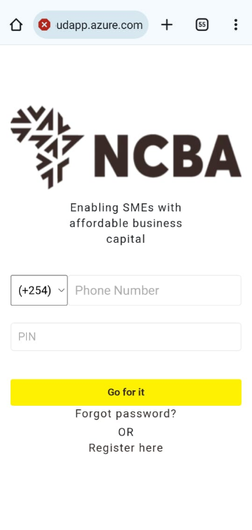
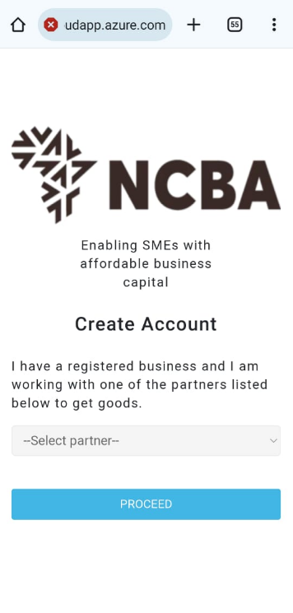
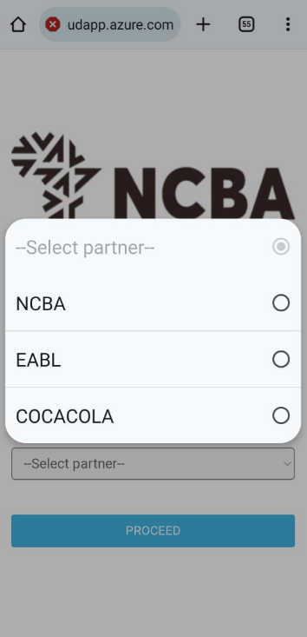
Step 1: Customer on-boarding
The landing page allows 1st time users to proceed with registration while existing users to login to the platform
On successful data upload, the user gets an invite SMS with a link to download the APK/WEB link
Select the Anchor
Existing users
1st time users

Slide 18
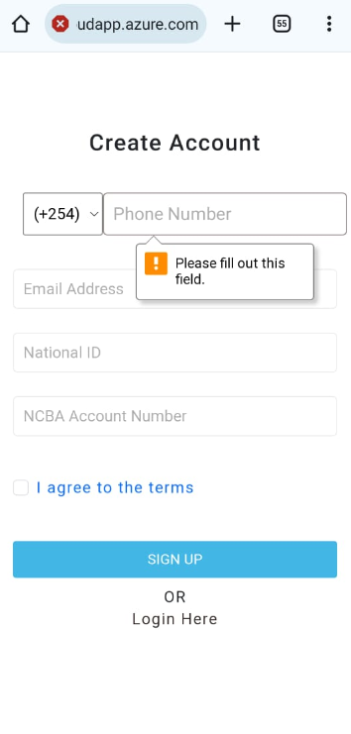
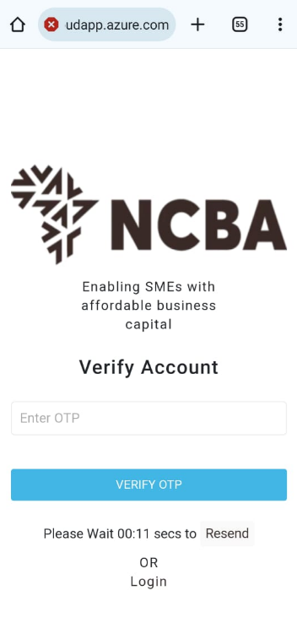
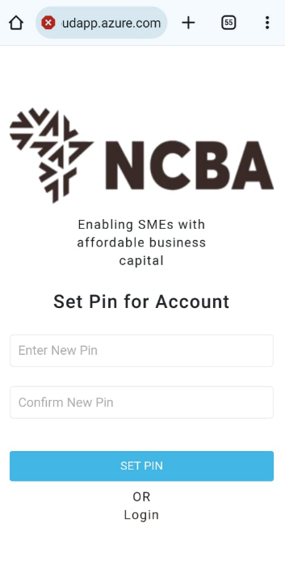
Step 2: Customer on-boarding: Accept terms & conditions
The customer should enter their personal details as they exist in the core banking and will be prompted to create a new PIN
Details authentication and terms & conditions

Slide 19
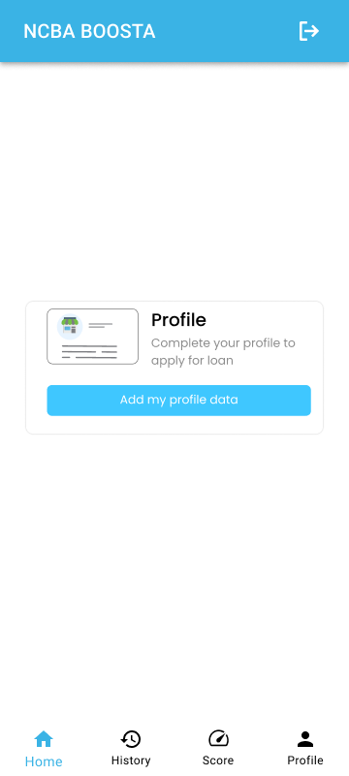
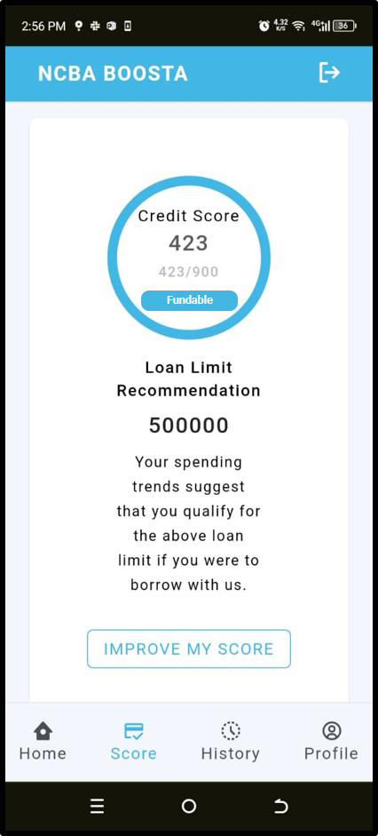


Step 3: Customer Profile Update
The customer will proceed and update their personal profile details

Slide 20




Step 4: KYC Documents upload
Upon filling of the personal details, the customer will proceed and upload the ID copy and take a photo
National ID & Profile Picture Upload

Slide 21




Step 5A: Business Profile Update
The customer will choose the business entity operated. This will dictate the documents to be submitted

Slide 22



Step 5B: Business Profile Update…cont
Business entity profile

Slide 23


Step 6: Business Documents upload
Once the profile is duly completed and all the business documents uploaded successfully, a confirmation message will be displayed to the customer
Business documents uploaded & profile update confirmed

Slide 24


Step 7: How to improve the score
In case the customer is not satisfied with the limit allocated, they can upload their M-Pesa statement to improve the score

Slide 25



Step 8: Loan Application & notifications
Upon confirmation of the amount to be financed, the customer will proceed with loan application and the funds will be disbursed directly to the Anchor’s account and all the parties are notified on the transaction.
SMS to the customer
Dear Bonface, Your NCBA BOOSTA Loan KES. XXXX has been successfully approved and will be disbursed shortly
SMS to the Anchor
Confirmed. Purchase of KES XXX has been paid by Bonface Macharia to EABL Ref No. FTX24044GAAAE

Slide 26



Step 9: Loan Repayment – Partial or Full Payment
On the due date, the system will automatically recover the funds from the customer’s account. However, the customer can initiate the loan repayment for either full or partial payment. The source of funds can be either NCBA account or M-Pesa wallet

Slide 27


Step 10: Notifications upon Successful Loan Repayment
Upon successful loan repayment, the customer will be notified on the same via an SMS.
Dear Bonface Macharia, your NCBA BOOSTA App Loan repayment initiated. To continue enter OTP 324646. Message Id z3S74/LREQ9
Partial: “Dear Bonface, partial payment of KES 1000.00 on your NCBA BOOSTA loan has been received. Your loan balance is now Ksh 7025.02. For inquiries call 07***64”
Full: “Dear Bonface, You have now fully repaid your loan of amount Kshs 20000.00. To request for another loan visit our NCBA BOOSTA App”

Slide 28


Loan Management Service (LMS) Dashboard

Slide 29

THANK YOU

